Slide 1
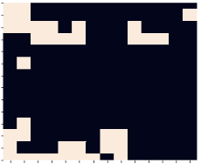
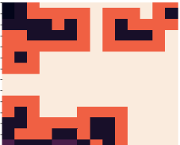

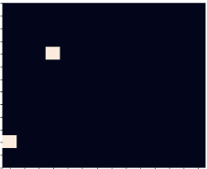
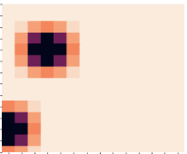
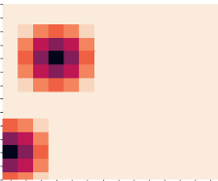
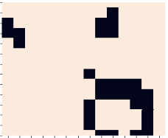
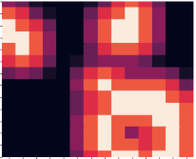
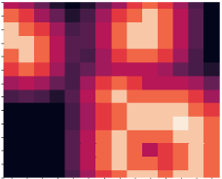
Label
Loss
Original Boundary loss

Slide 2
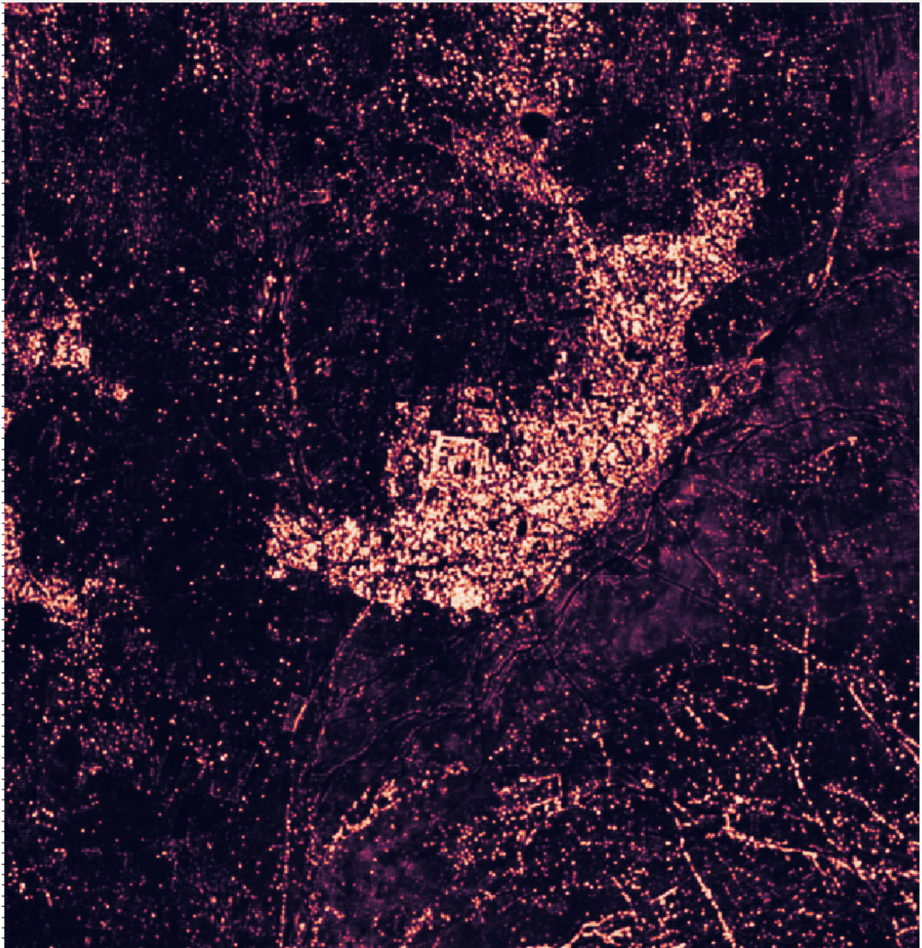
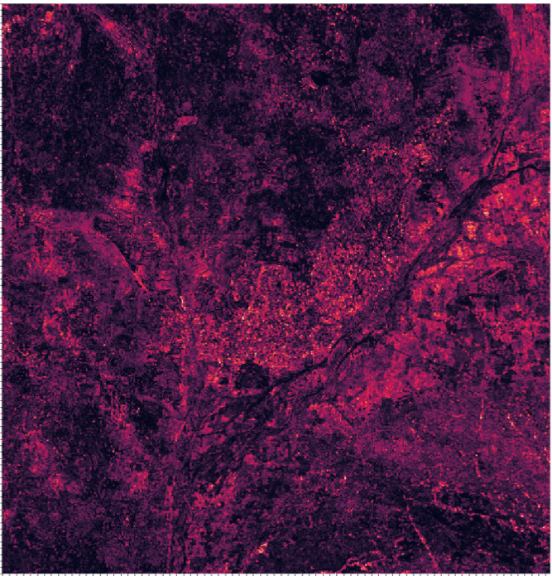
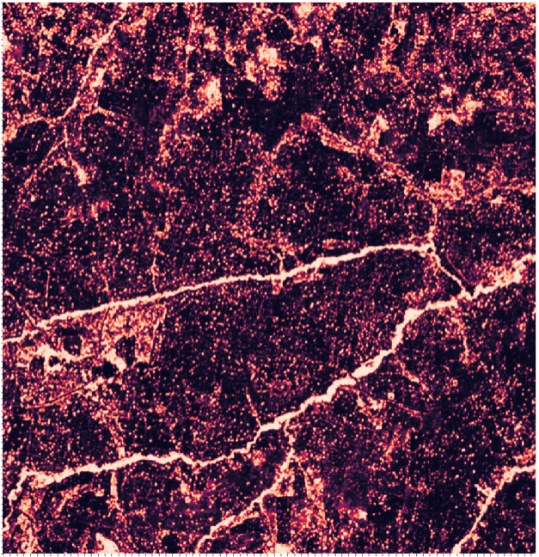
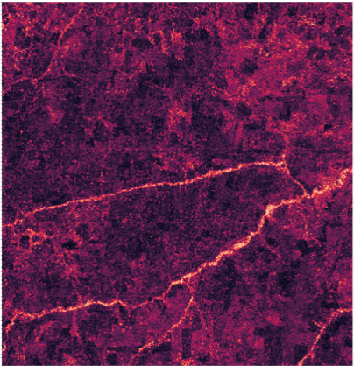

Slide 3
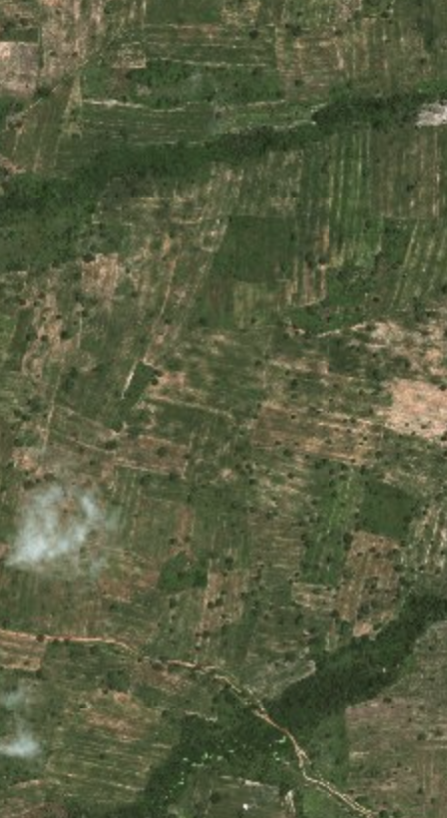
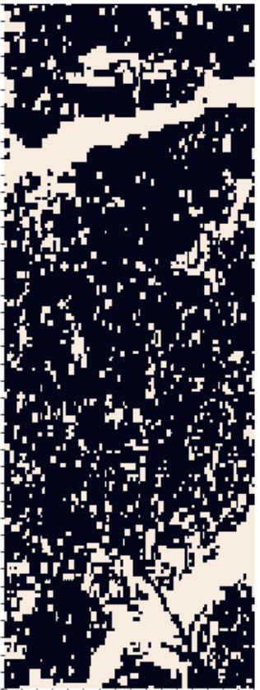
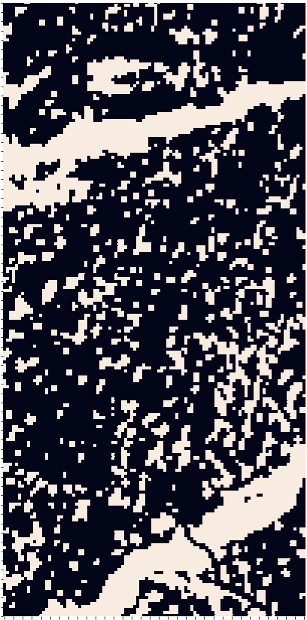
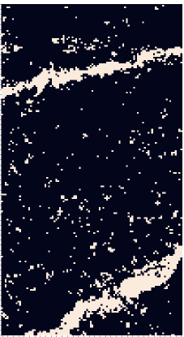
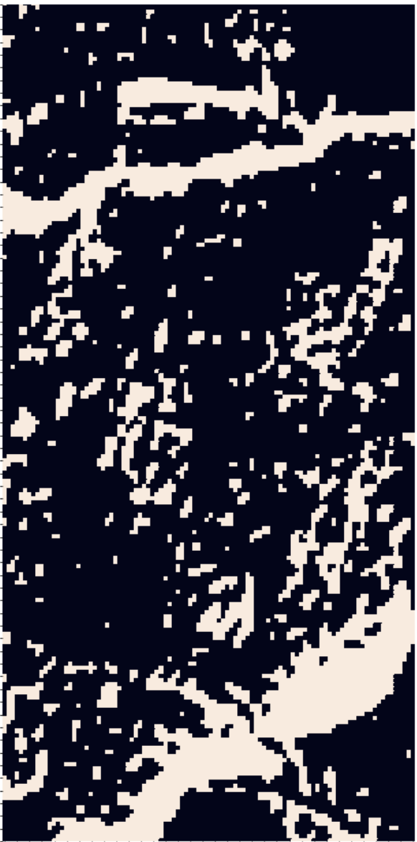
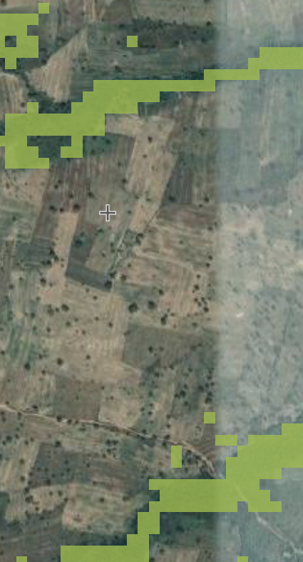
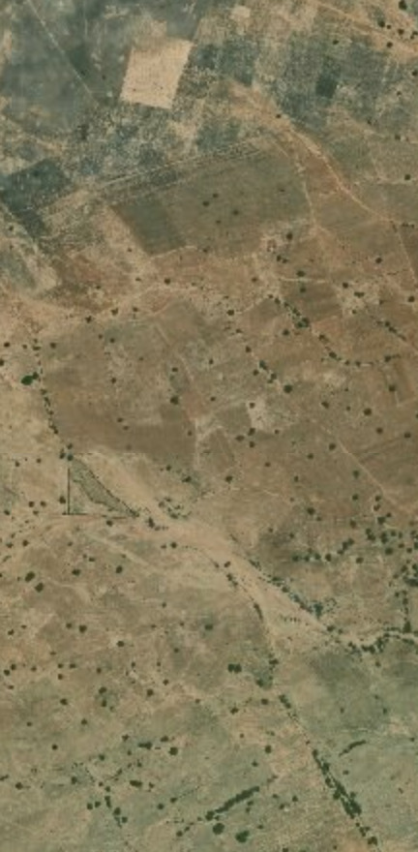
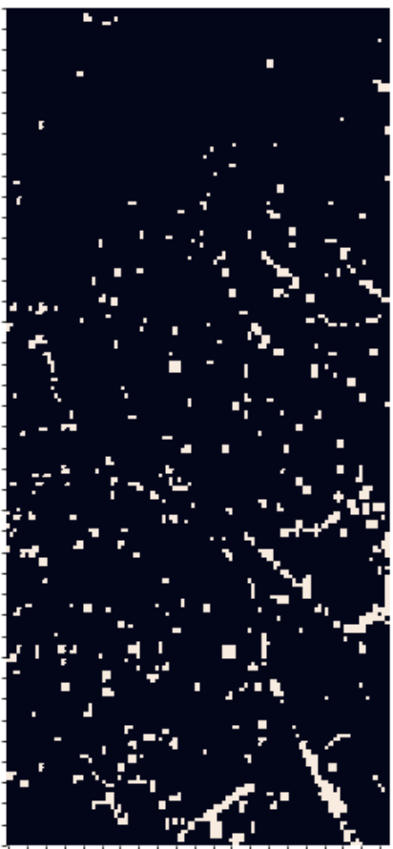
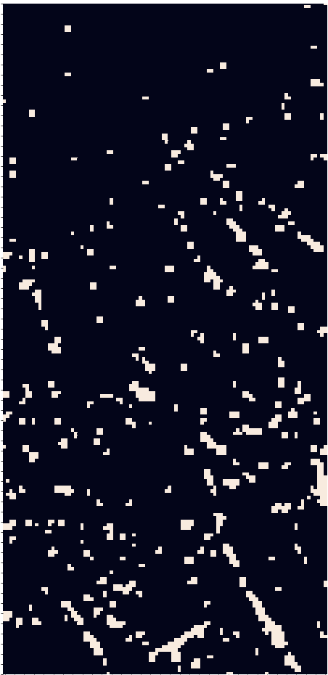
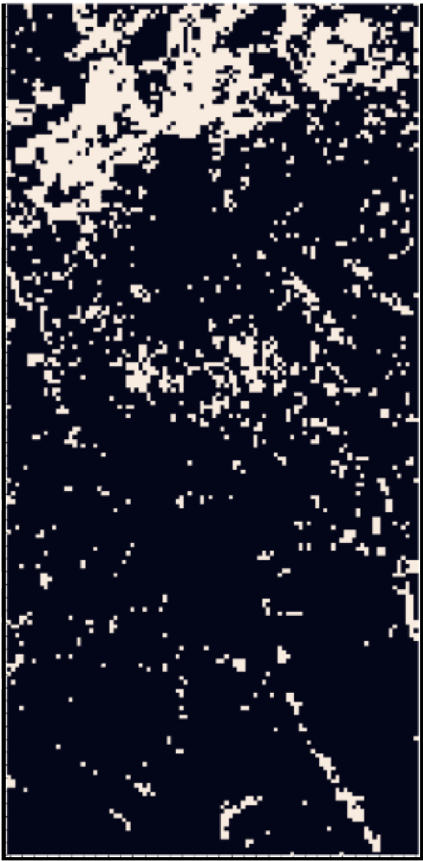
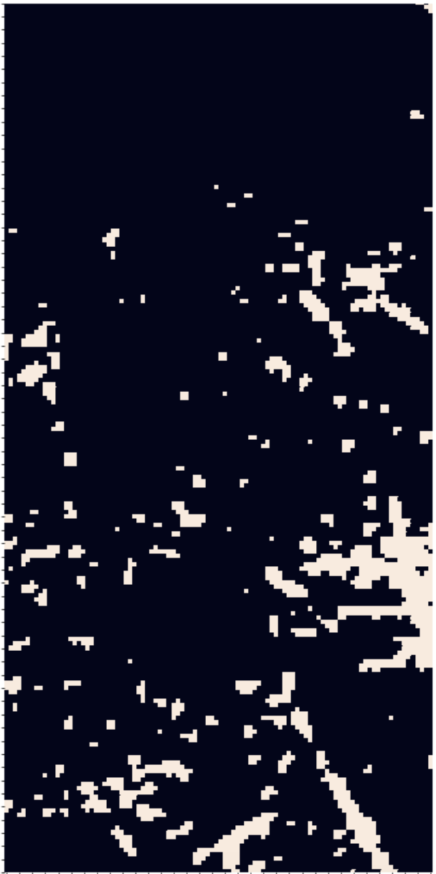
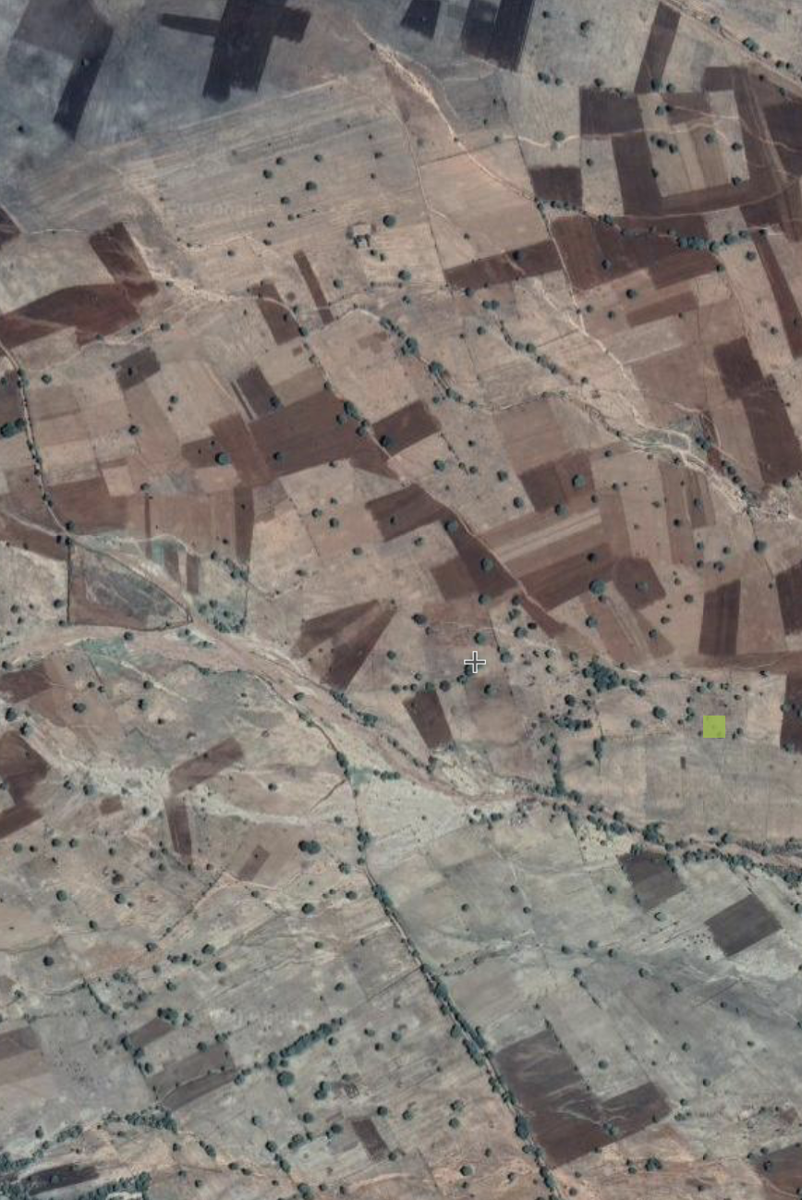
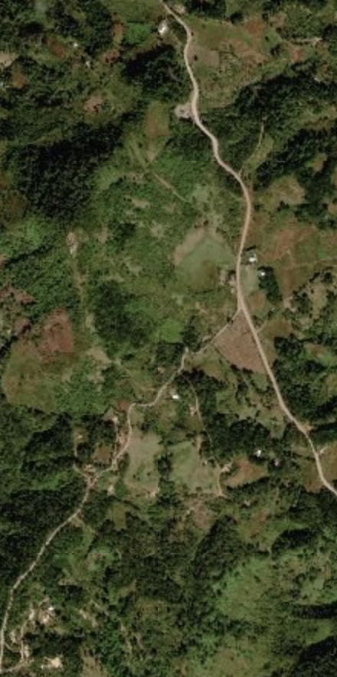
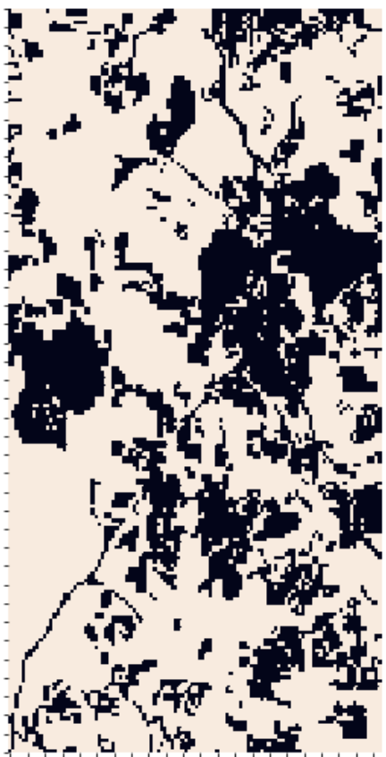
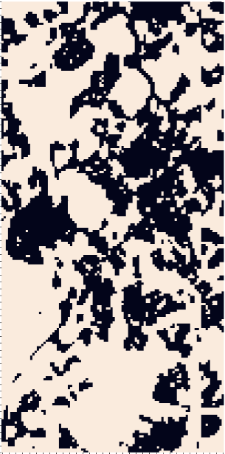
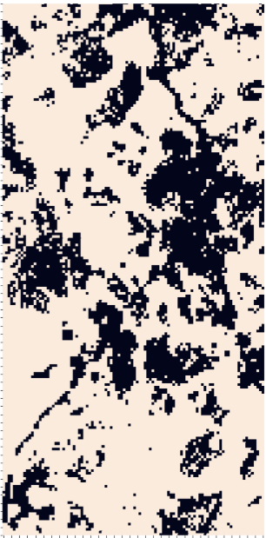
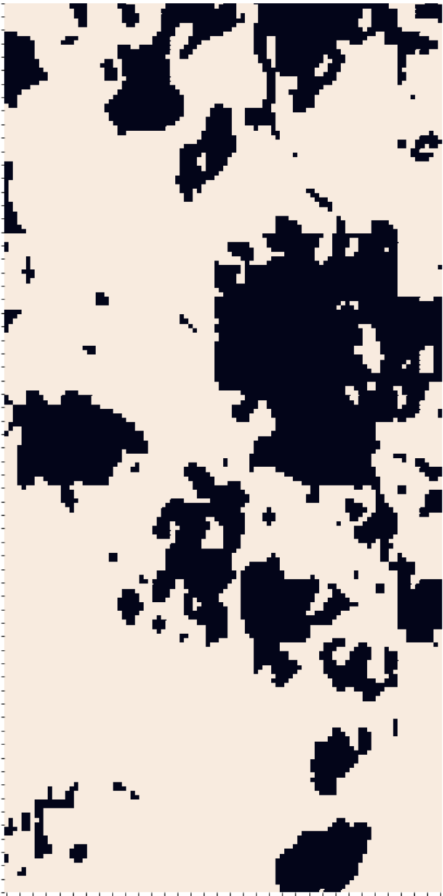
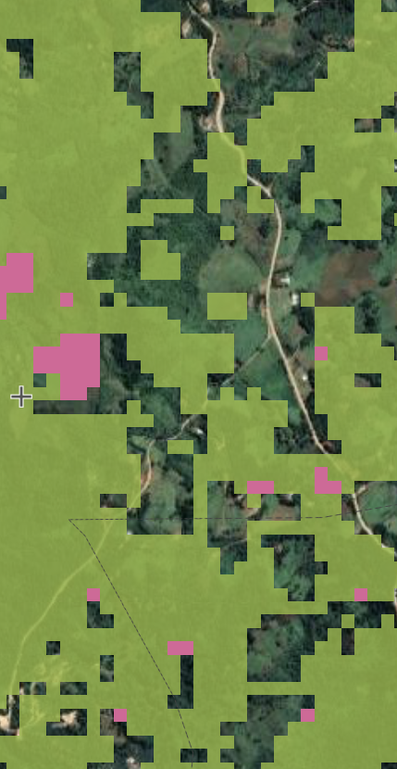
Base map
Label
Proposed model
Random Forest
U-net
Hansen et al. 2013
Ghana
Tanzania
Honduras

Slide 4
(a)
(b)
(c)
(d)
(e)
(f)
(i)
(ii)
(iii)

Slide 5
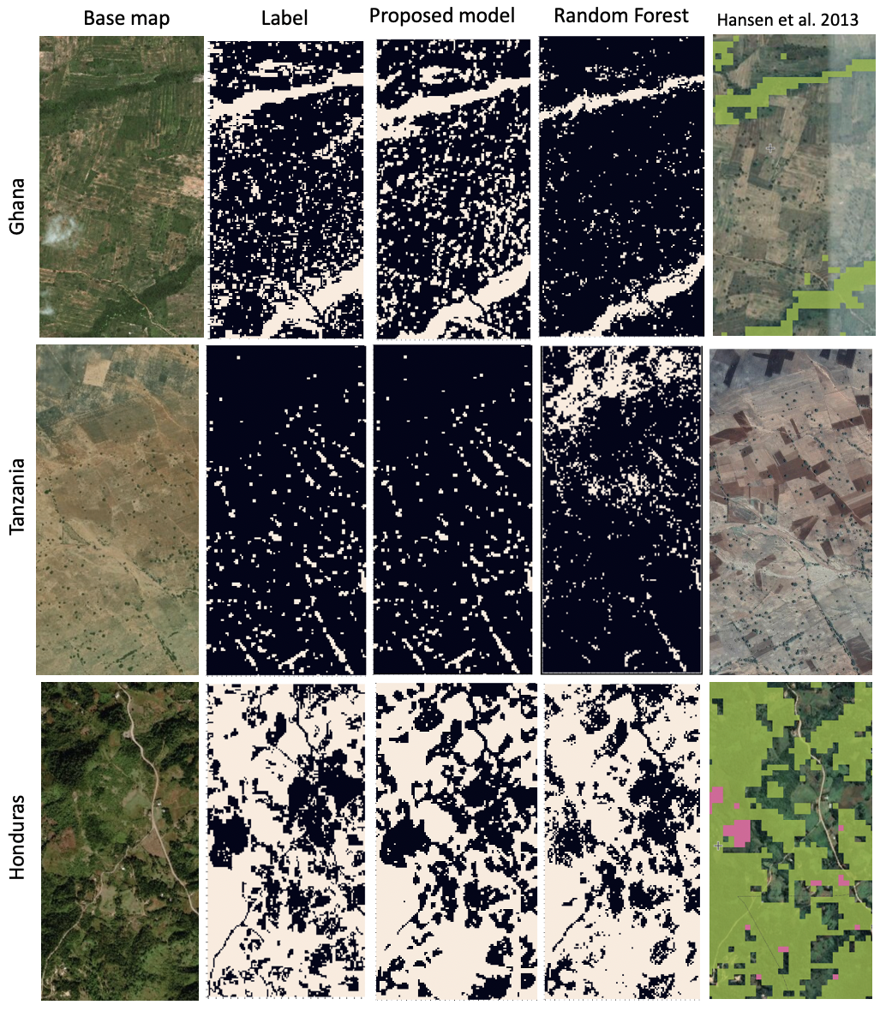
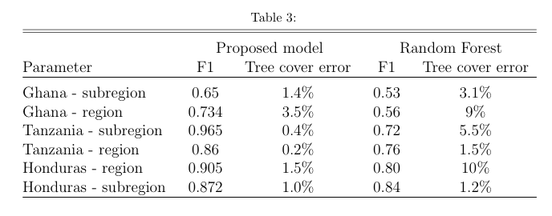
U-net

Slide 6
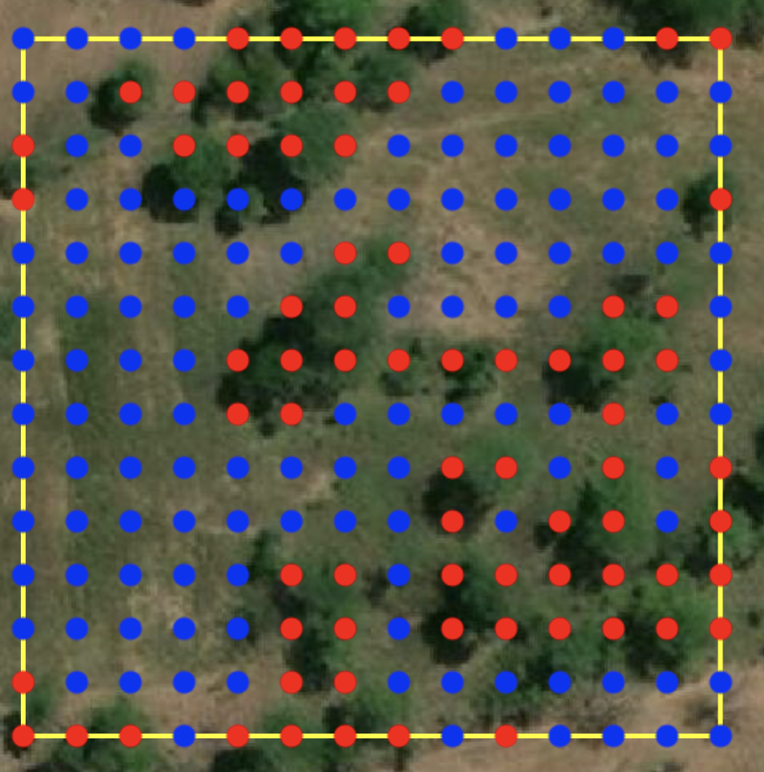
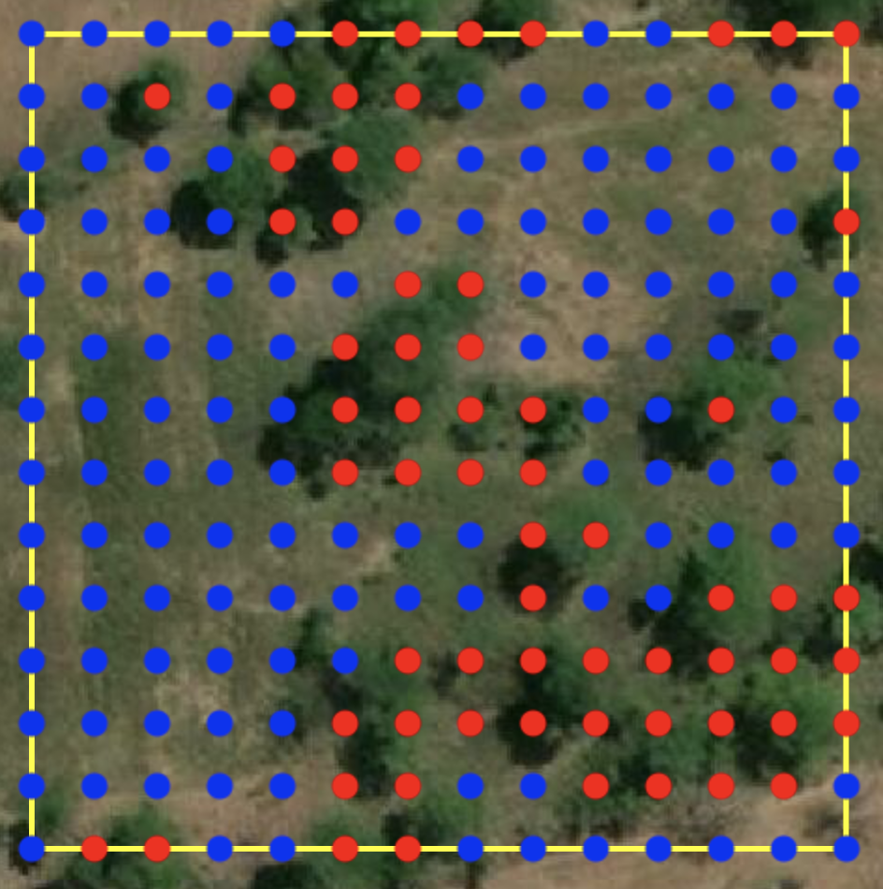
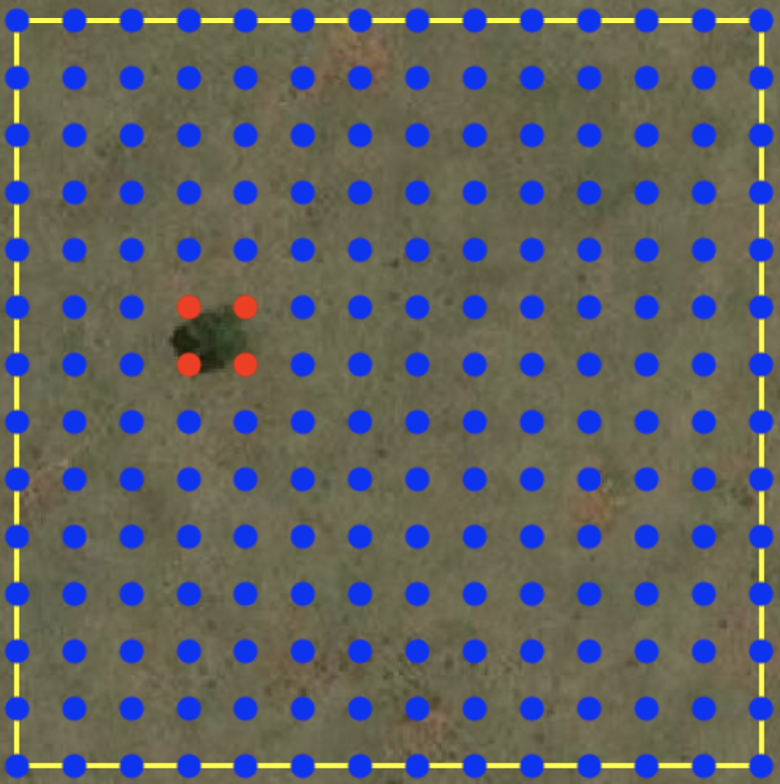
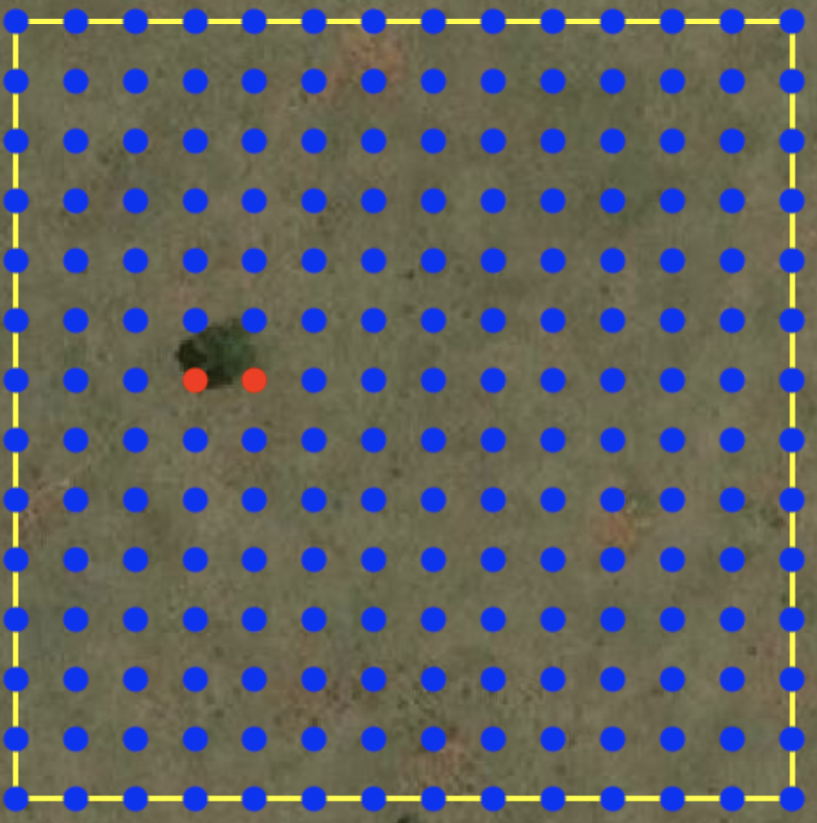
UA = 0.65, PA = 0.71 UA* = 0.93, PA* = 0.98
UA = 0.94, PA = 0.96
UA* = 0.94, PA* = 0.98
UA = 1.0, PA = 0.5 UA* 1.0, PA* = 1.0
UA = 1.0, PA = 1.0 UA* 1.0, PA* = 1.0

Slide 7
(a)
(b)
(c)
(d)

Slide 8
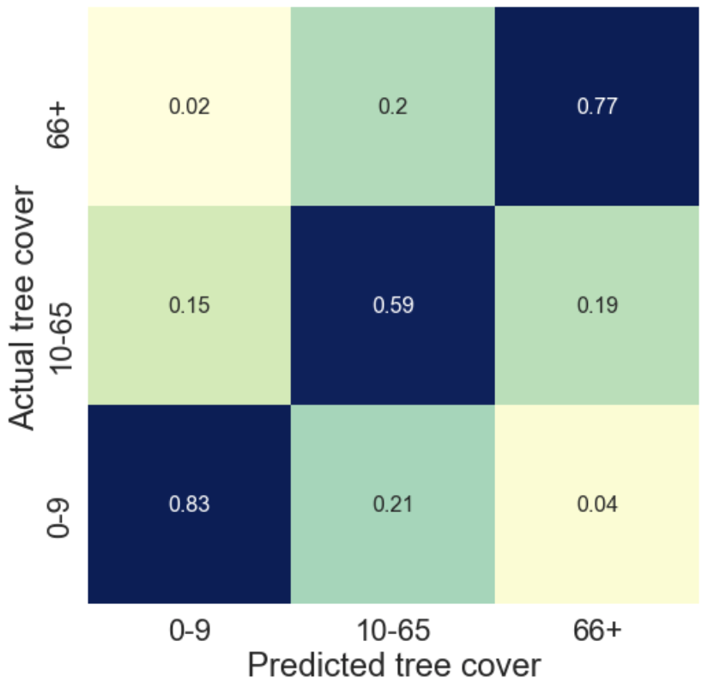
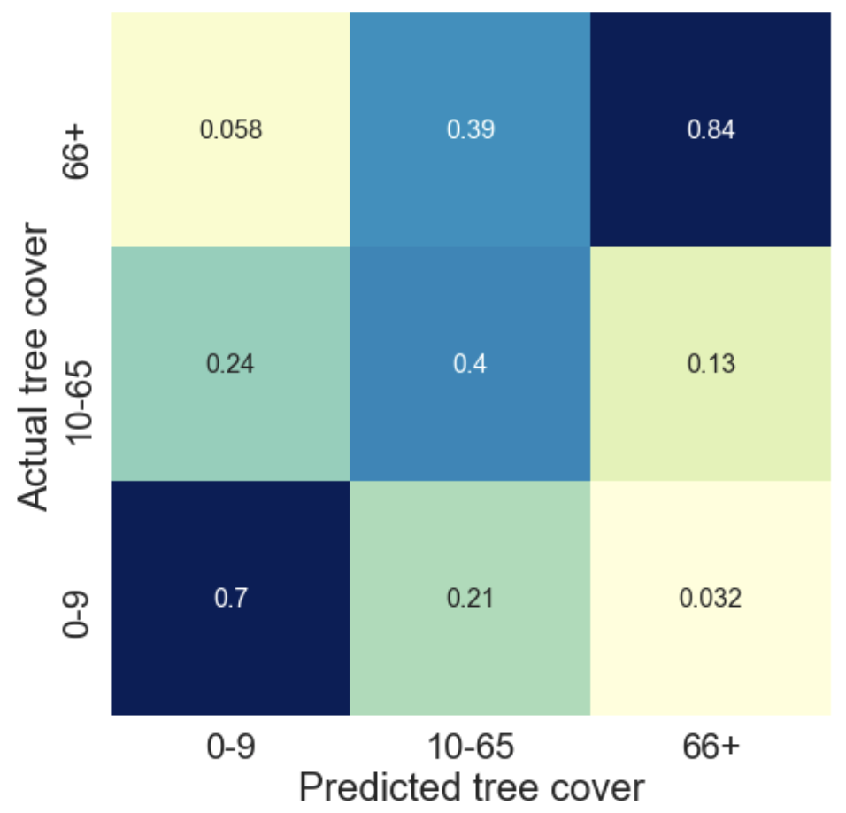
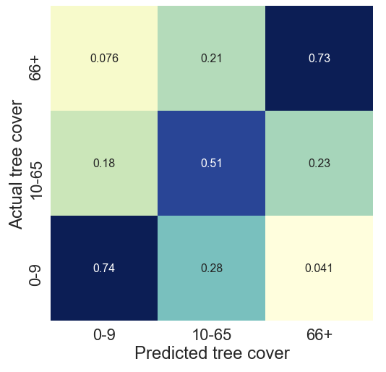
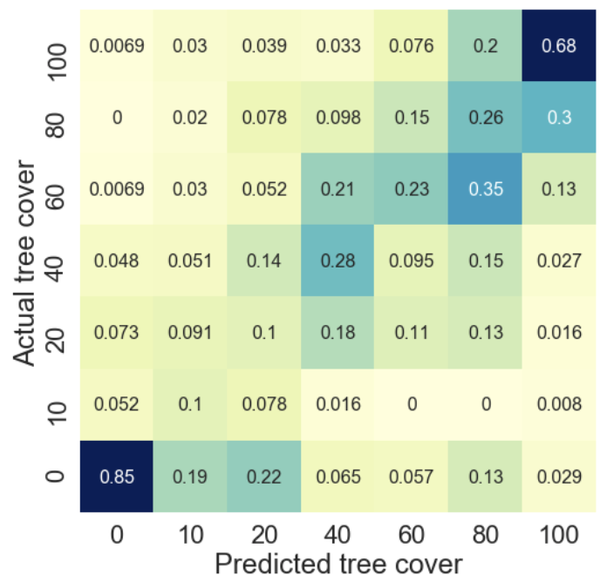
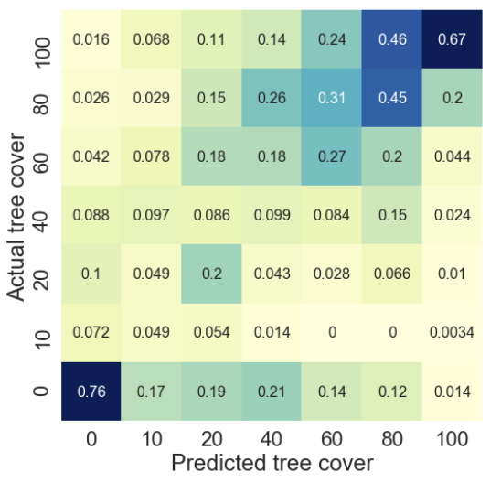
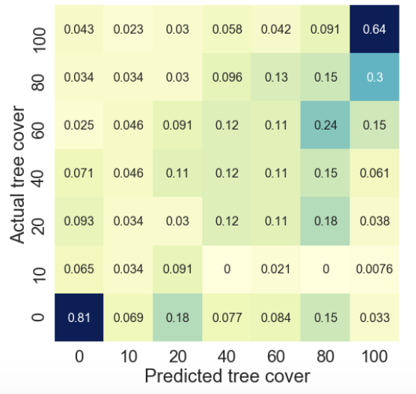
Proposed Random Forest U-Net
Proposed Random Forest U-Net

Slide 9
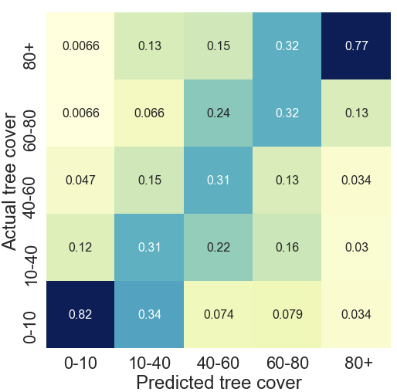
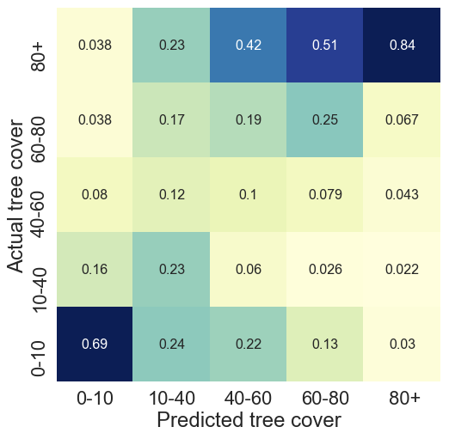
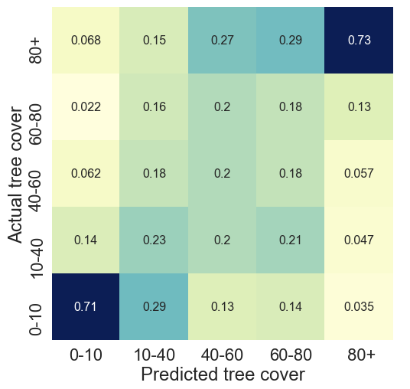
Proposed Random Forest U-Net

Slide 10
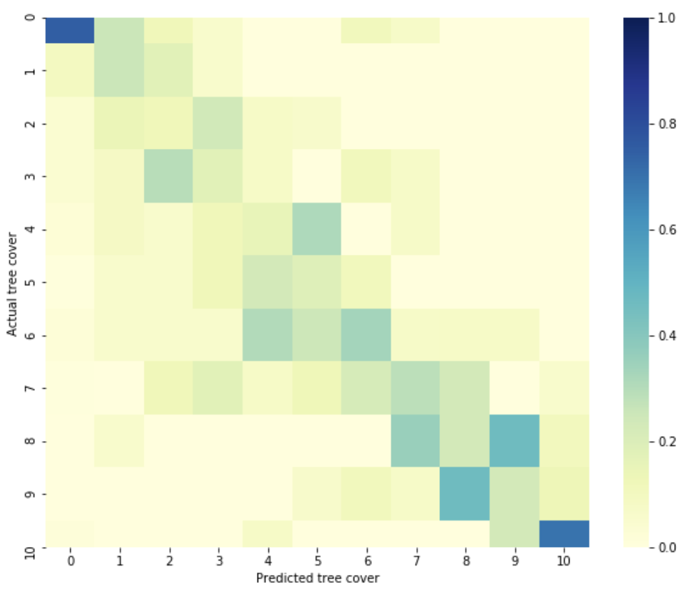
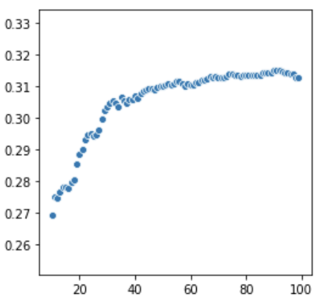

Slide 11
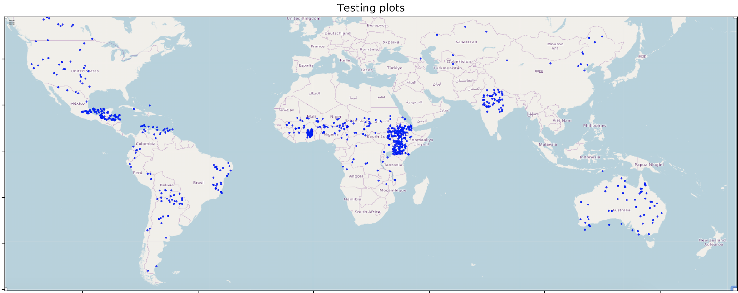
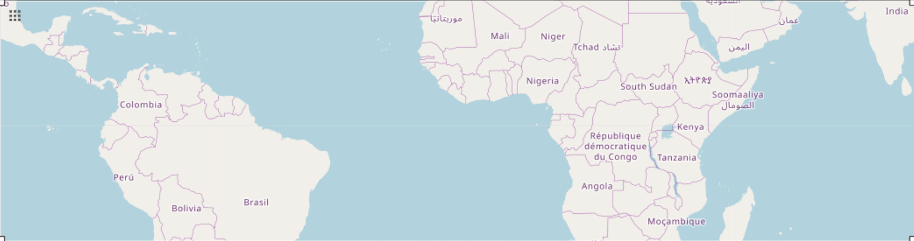
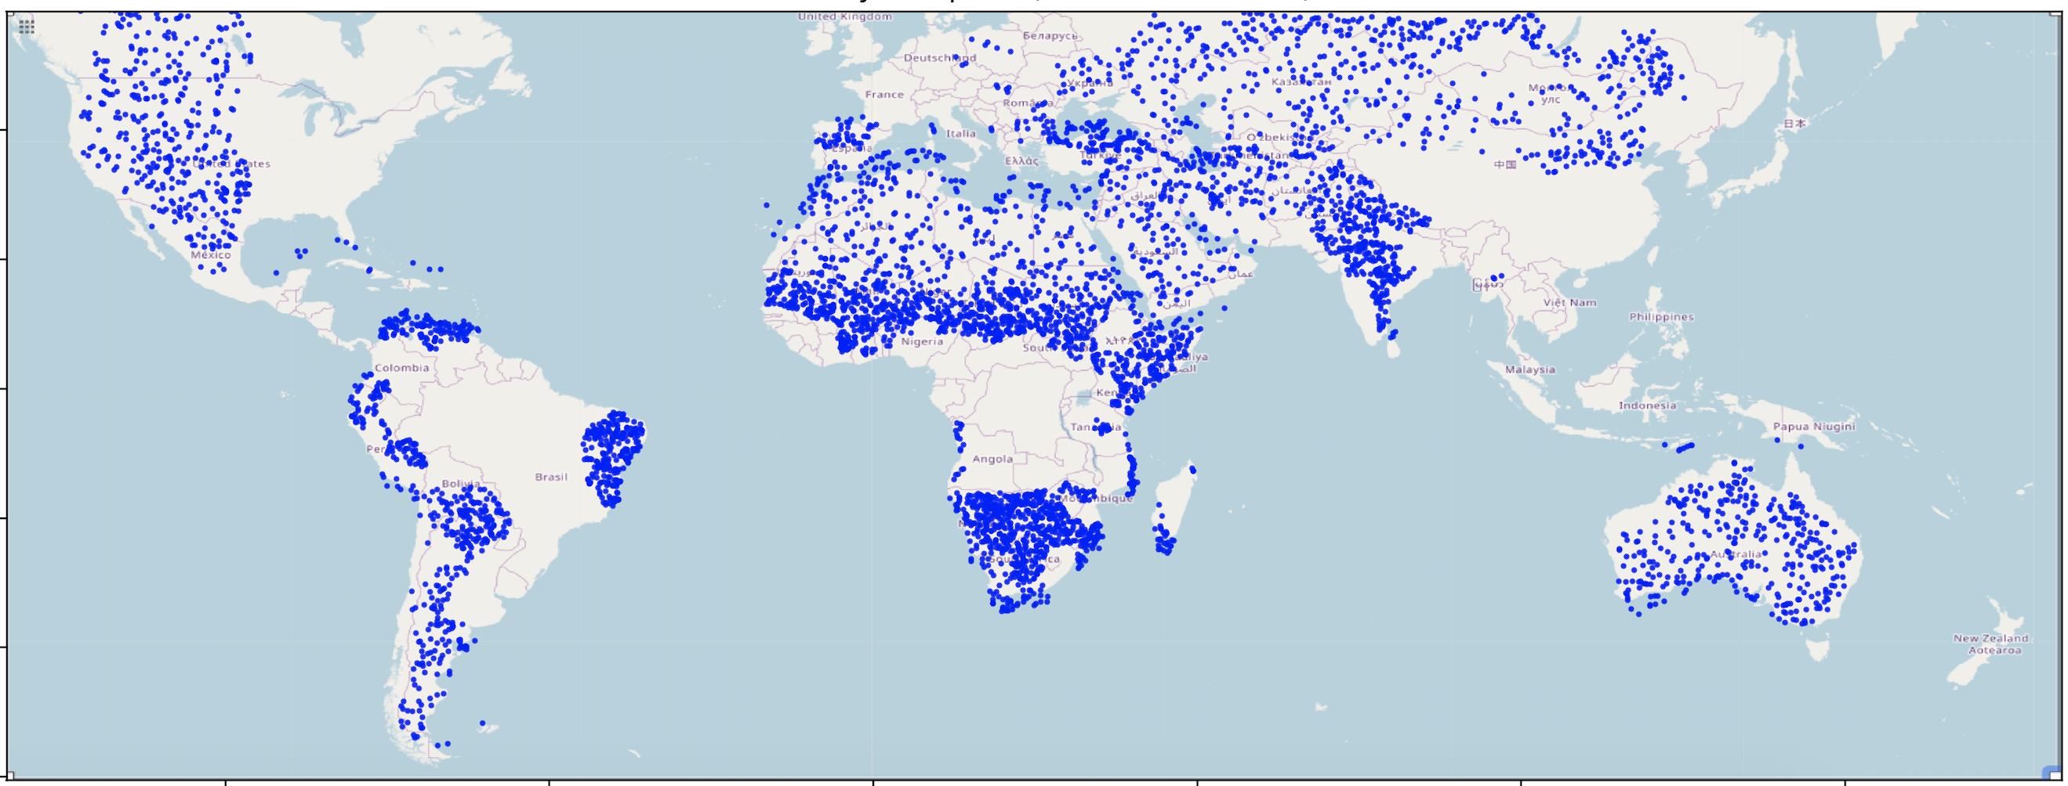

Slide 12




Slide 13









Slide 14


Non-shifted data is 80x80m

Slide 15









√
a) High resolution image
c) Predictions from Zhang et al. 2019
e) Predictions from this paper
d) Predictions from Zhang et al. 2019
f) Predictions from this paper
Notes:
TANZANIA 2[340:405, 98:163], 0.125, 0.325

Slide 16
a) High resolution image
c) Predictions from Zhang et al. 2019
e) Predictions from this paper
d) Predictions from Zhang et al. 2019
f) Predictions from this paper

Slide 17
Google form, goes to email
Cloud scheduler, microinstance (every 4 hours)
Checks email
Scrapes input to a CSV, stored on a private bucket
Checks tile folder for unsent tiles, and send email back to request if tiles are done
Cloud scheduler, CPU instance (every day)
Checks stored CSV for new data requests
Downloads data, stores to bucket
Cloud scheduler, GPU instance (every day)
Checks data bucket for unprocessed tiles
Process tiles with tensorflow

Slide 18
(a)
(b)
(c)

Slide 21
(a)
(b)
(c)

Slide 22
(a)
(b)
(c)
(d)

Slide 23
(a)
(b)
(c)
Actual tree cover (%)
0 to 10 10 to 40 40 to 60 60 to 80 80+
Actual tree cover (%)
0 to 10 10 to 40 40 to 60 60 to 80 80+
Actual tree cover (%)
0 to 10 10 to 40 40 to 60 60 to 80 80+
0 to 10 10 to 40 40 to 60 60 to 80 80+
Predicted tree cover (%)
0 to 10 10 to 40 40 to 60 60 to 80 80+
Predicted tree cover (%)
0 to 10 10 to 40 40 to 60 60 to 80 80+
Predicted tree cover (%)

